Slide 1

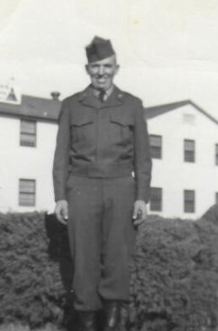

Donald Adams
Army
Rank-Corporal
22 Months of Service
Fought in the Korean War

Slide 2
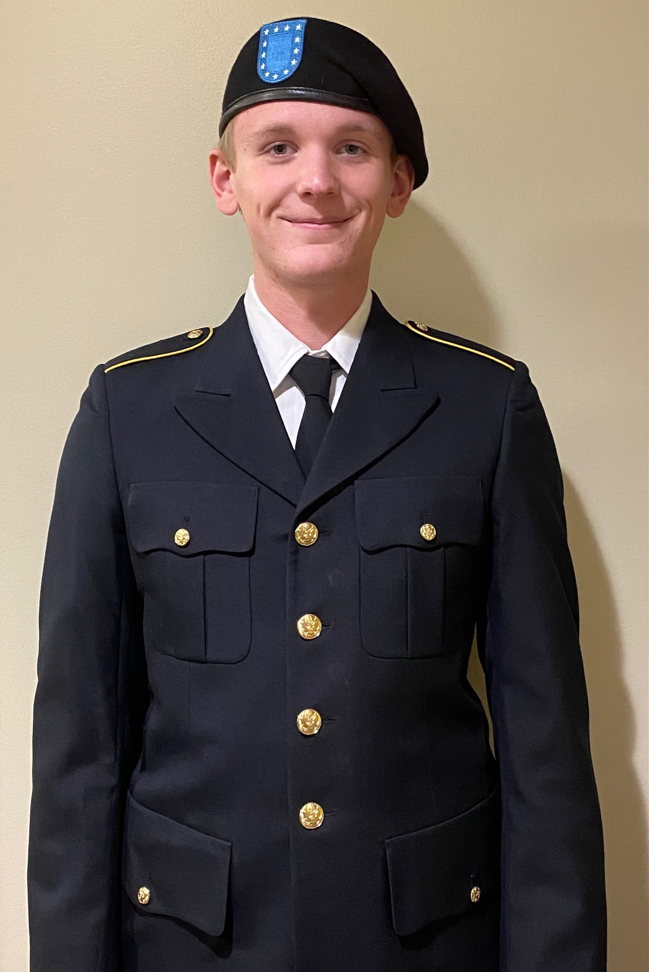
Silas Brown
Army ROTC
Presently in Columbia, MO.

Slide 3
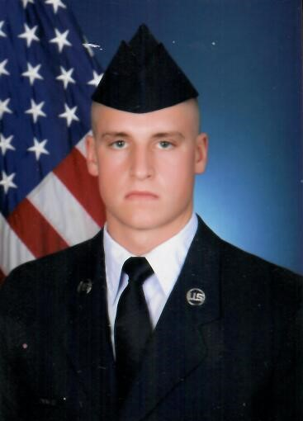
Luke Calvert
Air Force
Meteorology specialist for aircraft
Rank- Staff Sergeant
Served 2016-present
Stationed in Kandahar, Afghanistan

Slide 4
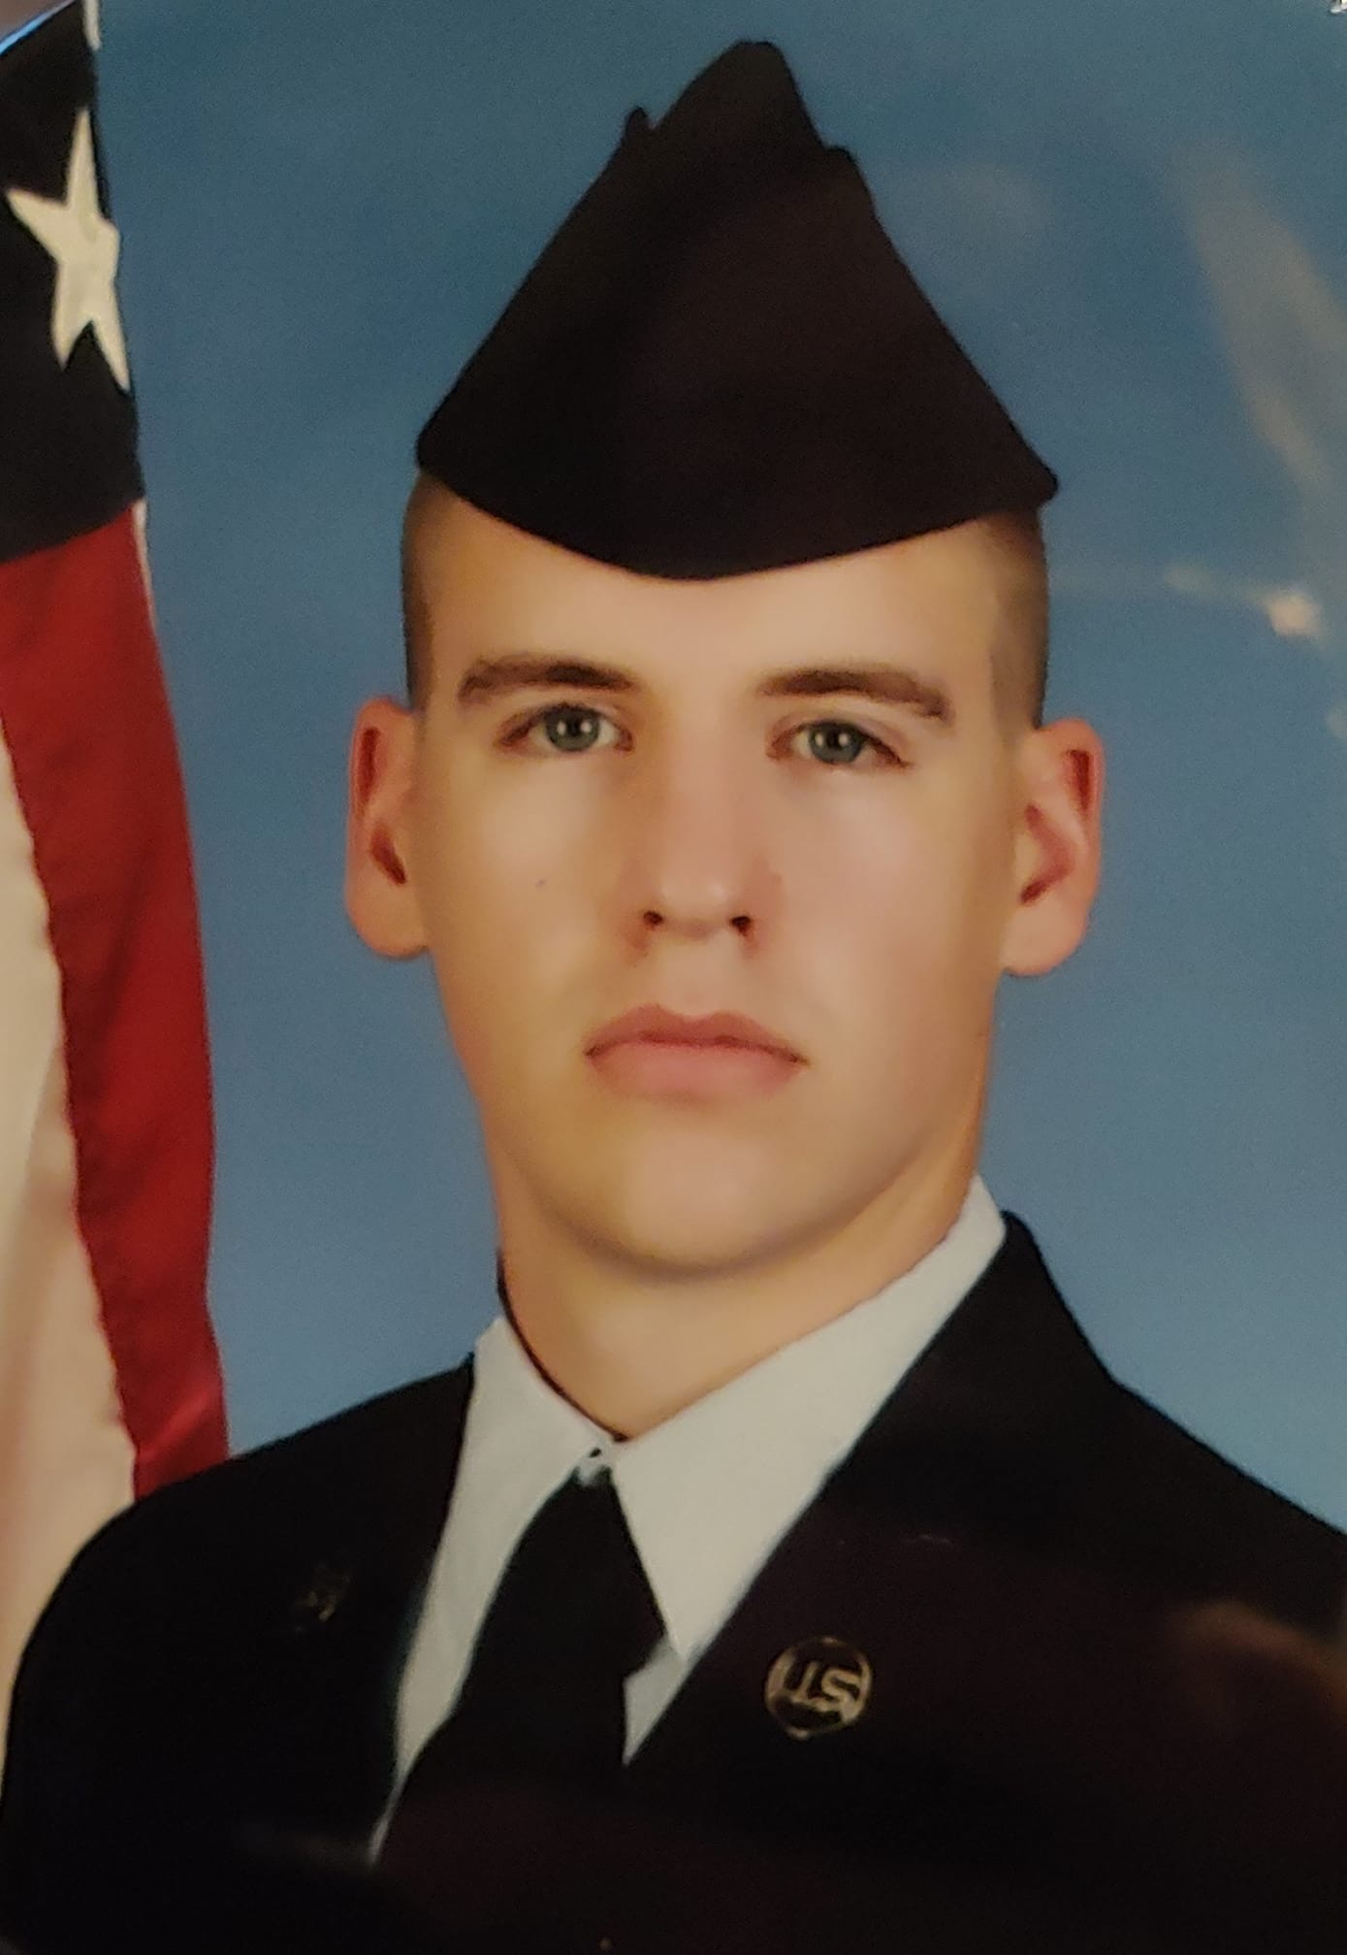
Seth Calvert
Air Force
Rank-A1C Airman 1st Class
1 Year of Service
Stationed in Sumter, N.C.
He is an Aerospace Propulsion Journeyman

Slide 5
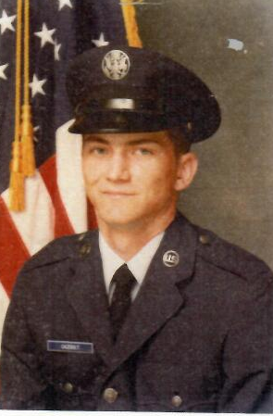
Jack Lynn Casebolt II
Air Force
Rank- Staff Sergeant E4
10 Years of Service
Served in Desert Storm

Slide 6
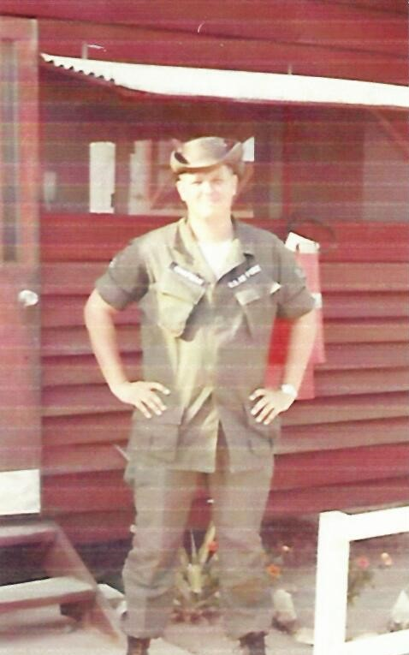
William Chapman
Air Force
Sergeant E-4
Served 1966-1969
Fought in Vietnam

Slide 7
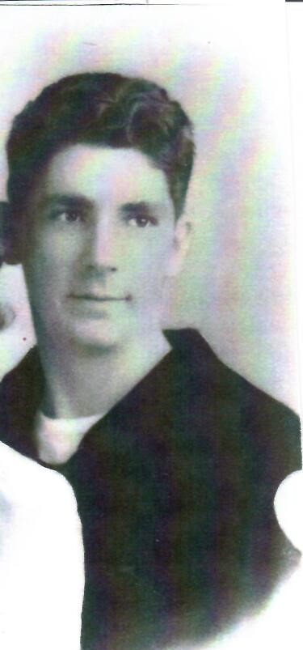
Merlin Clark
Merchant Marine
Rank AB

Slide 8
Robert DeVoy
Army
Sergeant 1st Class
Served 1950-1952
Fought in Korea

Slide 9
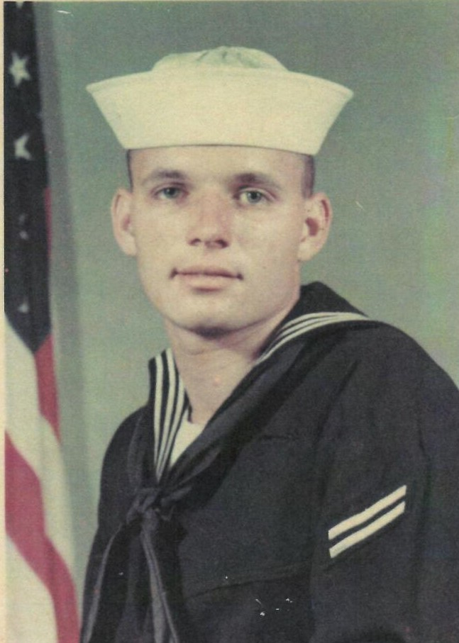
Daniel Dye
Navy
Rank E-3
4 Years of Service
Fought in the Vietnam War.

Slide 10
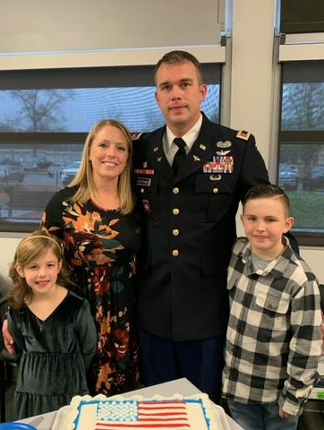
Adam Fletcher
Son of Julie Gundy
Army-Chief Warrant Officer E4
20 years of service
Apache and Kiowa helicopter pilot and instructor.
3 tours in Afghanistan
Stationed in Ft. Bragg,N.C
Ft. Rucker Al, Ft.Campbell, KY
& Ft. Lewis, WA

Slide 11
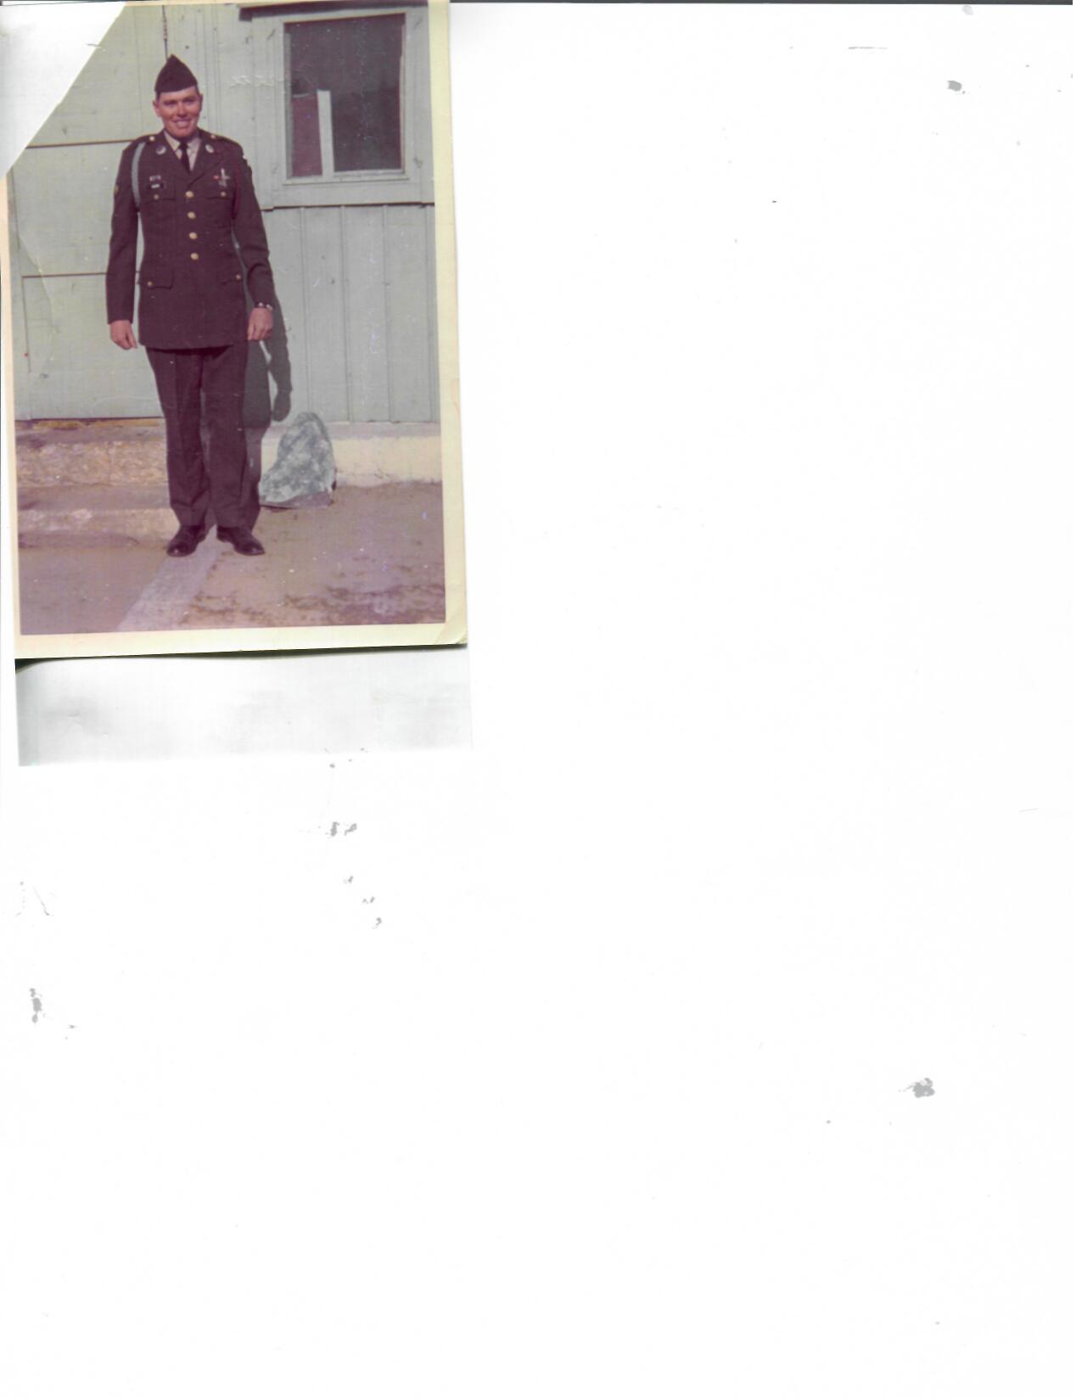
Richard (Dick) Garr
Army-2nd Infantry Division
Rank E4
Served from 1969-1971
Fought in Vietnam and was stationed in Korea

Slide 12
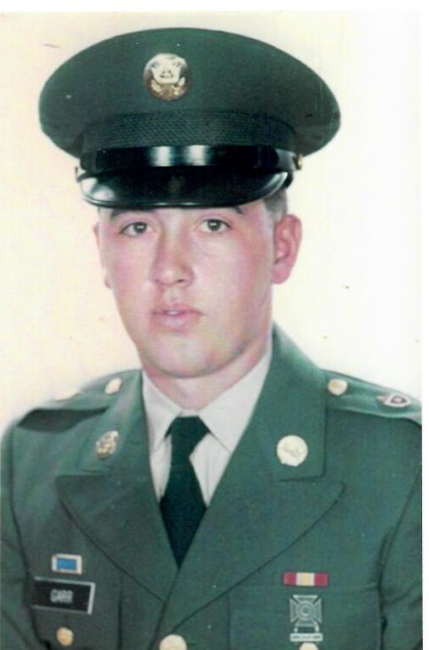
Bob Garr
Army
Rank-Specialist 4
Served from 1966-1968
Fought during the Vietnam Era

Slide 13
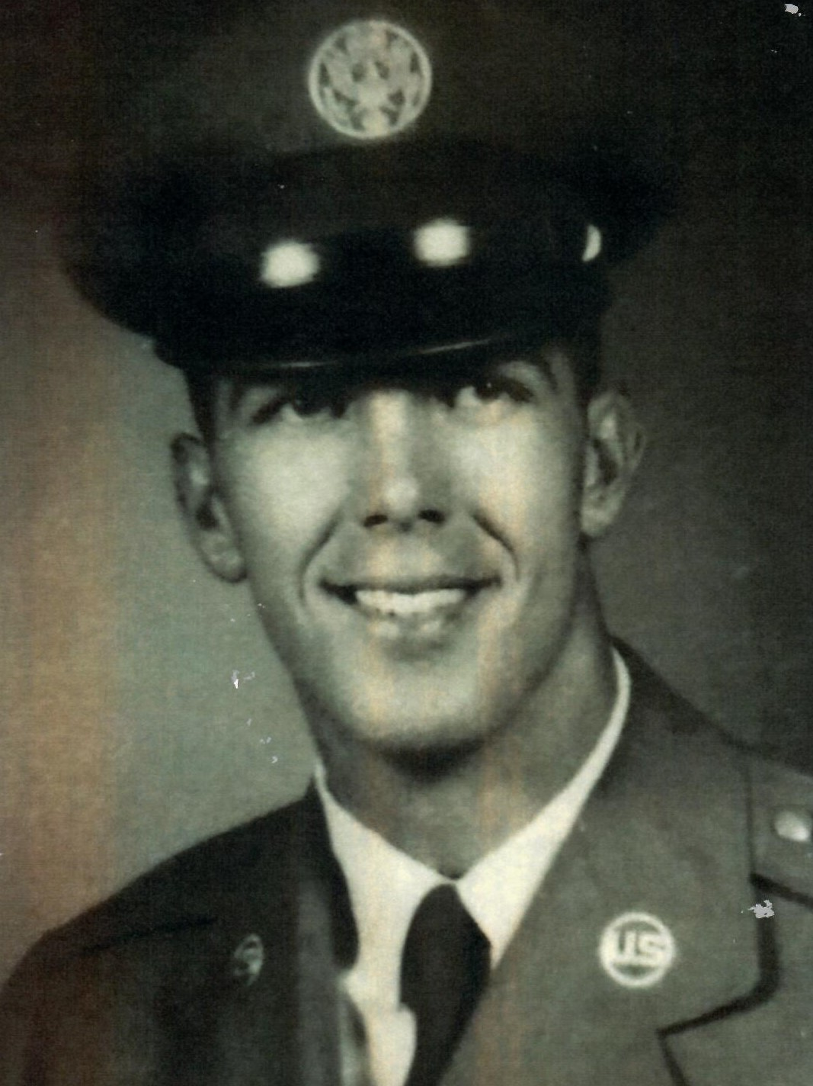
David Gates
Air Force
Sergeant
Served from 1965-1969
Fought in Vietnam

Slide 14
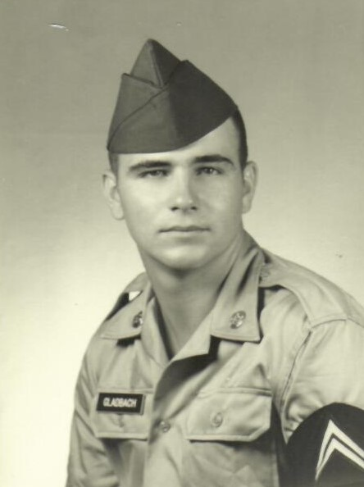
Robert Gladbach
Army
Rank- Specialist 4
Served 2 years

Slide 15
Tom Gladbach
Army
Rank-Private First Class
Served from 1962-1964
Served During the Vietnam Era

Slide 16
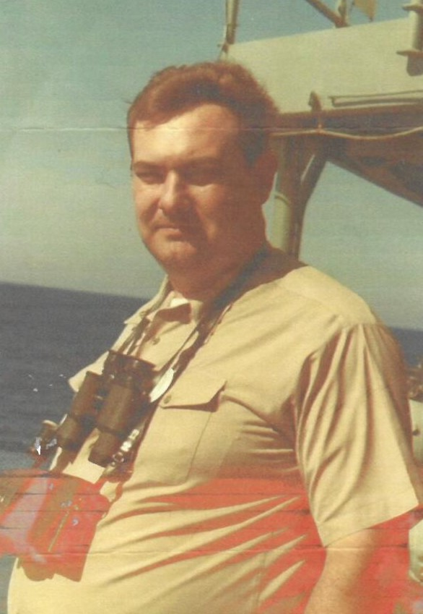
Danny Graves
Navy
Rank-Chief Petty Officer E7
Boiler Tender
20 years of service
Fought in Vietnam and other
Conflicts in the Middle East

Slide 17
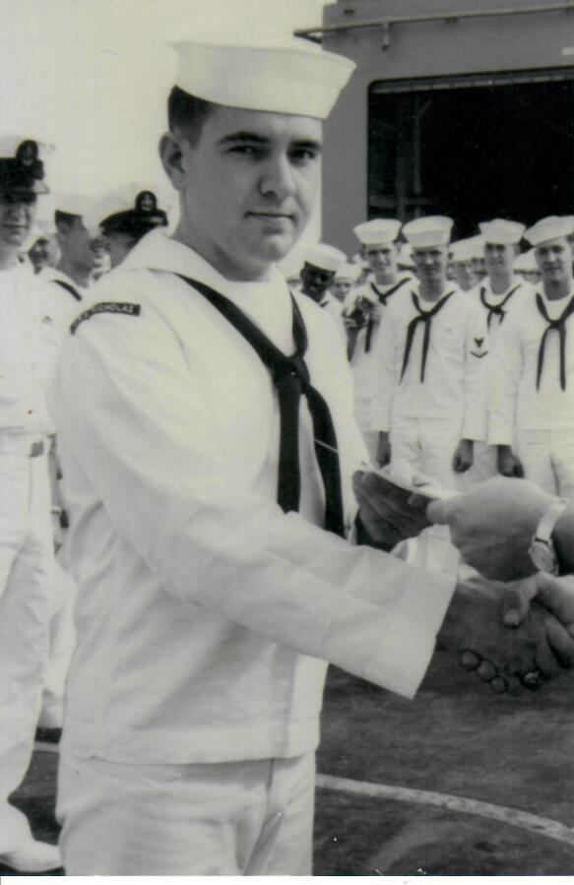
Larry Grothe
Father of Kara Marnin
Navy
Rank-Commissary 1st Class
Served from 1960-1969
Fought in Vietnam; patrolling the Gulf of Tonkin & South China Sea protecting carrier ships. Also involved in the Cuban Missle Crisis.

Slide 18
David Hortenstine
Army
Sergeant Instructor Supply School
Served 1968-1971
Stationed in Fort Lee, VA

Slide 19
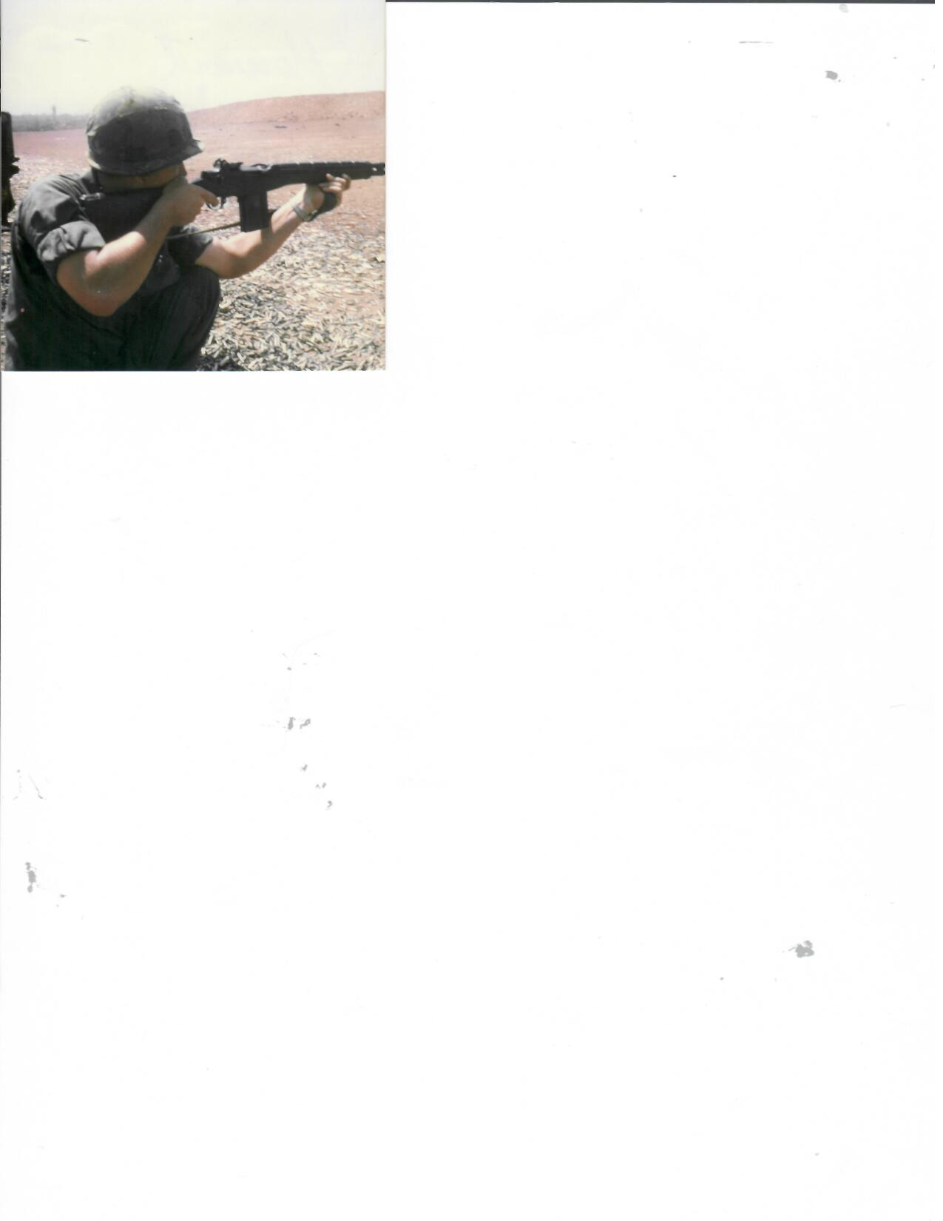
Howard Johnson
Army
Sergeant E5
3 Years of Service
Served in Germany, Vietnam and the Tet Offensive

Slide 20
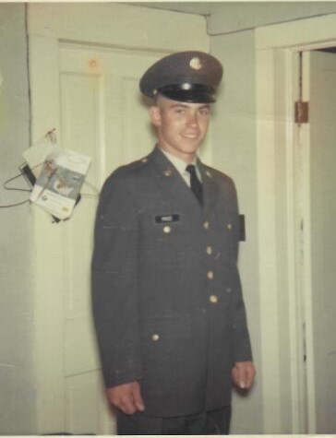
Danny Price
Army
Rank- Sergeant E-5
Served from 1966-1968
Fought during the Vietnam Era
Stationed at Ft. Leonard Wood, Ft. Gordon, Ft. McCellen,
Ft. Benning, Davis Relay Center

Slide 21
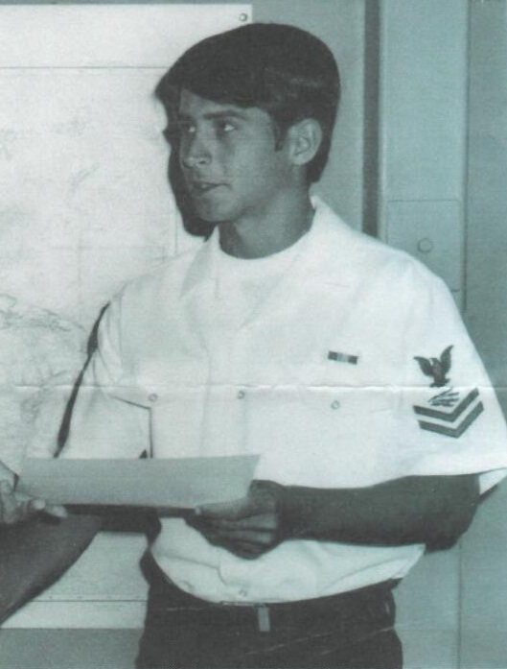
Clay Long
Navy
Rank-Petty Officer 2nd Class
Served from 1973-1977
Fought in Vietnam

Slide 22
Charles M. Myrick
Army
Specialist 4
Served 1966-1967
Fought in Vietnam

Slide 23
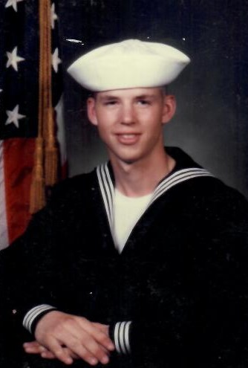
John Pore
(Brother of Sarah Willis)
Navy
MM3/E4
4 Years of Service

Slide 24
Rick Price
Army
Rank- E5
Served 1962-1964
Fought during the Vietnam
Era

Slide 25
Wayne Reigelsberger
Army
Corporal
2 Years of Service
Fought in Korea

Slide 26
Charles Douglas Smith
Army
Rank-Captain
Served from 1967-1978

Slide 27
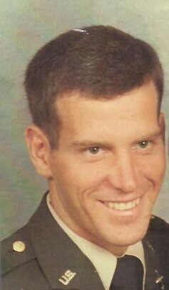
Kenneth Stark
Army
Rank-Lieutenant Colonel
Served from 1977-1999
Fought in Desert Storm

Slide 28
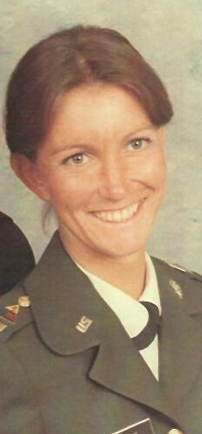
Martha Stark
Army
Rank- Captain
Served from 1979-1983
Served during the Cold War

Slide 29
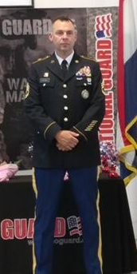
Brandon Stockwell
National Guard
Rank-Sergeant 1st Class
23 Years of Service
Served in Operation Noble Eagle, Operation Enduring Freedom and multiple emergency deployments.

Slide 30
Riley Young
Army National Guard
Rank-Staff Sergeant
12 Years of Service
Served in 4 State of Emergency Duties

